Slide 1
^{2 December 2023}

Slide 2







A Big Thank You to all the Sponsors!

Slide 3




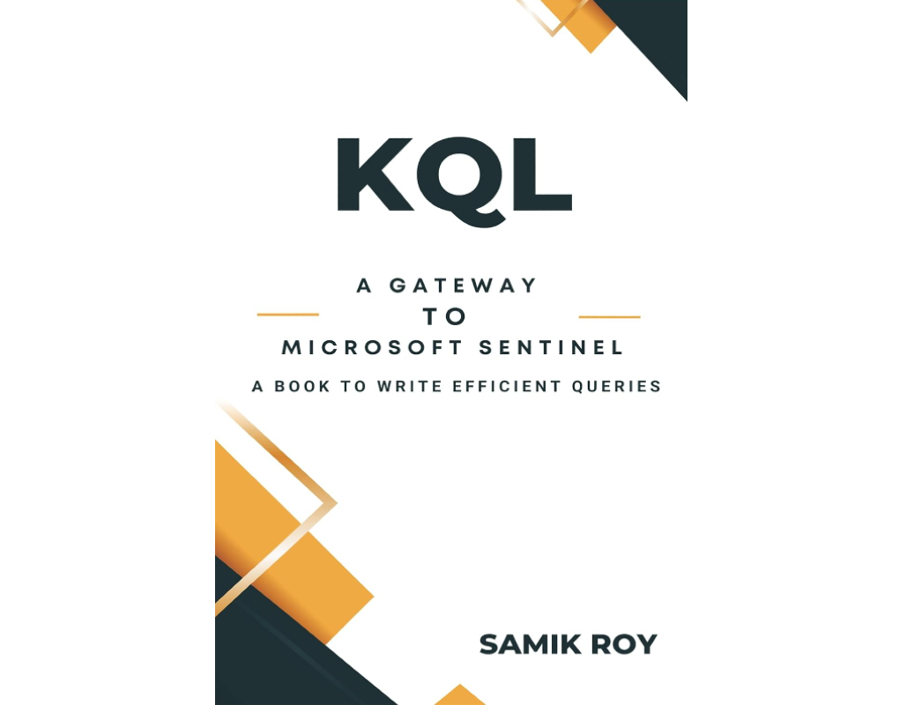
A One Day In Person Event
Win exiting prizes!
Hands on sessions by experts and community leaders
Deep-dive into Microsoft 365 Services
Focus on:
Microsoft Teams
Power Platform
SharePoint

Slide 4

Session 3
SPEAKERS PANEL
Introduction to M365 Graph Connector - Get external content to Microsoft 365
11.00 AM – 11.45 AM
Arjun Menon
Solution Architect - TCS

Slide 5







WHO AM I
Arjun Menon
Solution Architect with TCS
Microsoft MVP (M365 Development)
Maintainer – CLI for Microsoft 365
Core Team Member – Microsoft 365 Patterns & Practices (PnP)
/in/
arjunumenon
arjunumenon.com
This Photo by Unknown Author is licensed under CC BY
This Photo by Unknown Author is licensed under CC BY

Slide 6




Graph Connector. Jailer Metaphor

Slide 7
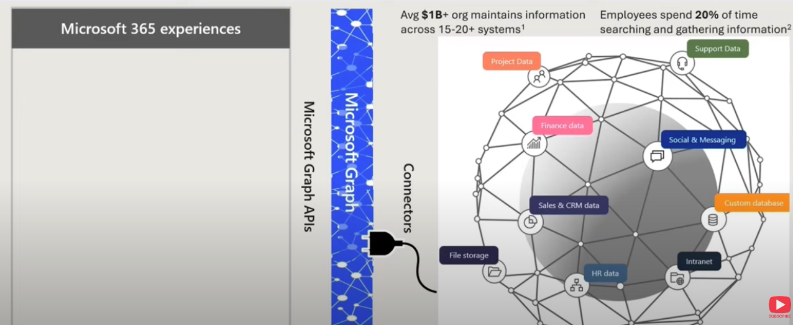

Graph Connector. What is that?

Slide 8
Graph Connectors Experiences
Microsoft Search
Context IQ on outlook
Microsoft 365 Copilot
Microsoft 365 App
Notes:
Experiences in the following M365 Areas
M365 Search
Context IQ in Outlook (Preview)
M365 Copilot
Any M365 Apps using Graph API Search

Slide 9
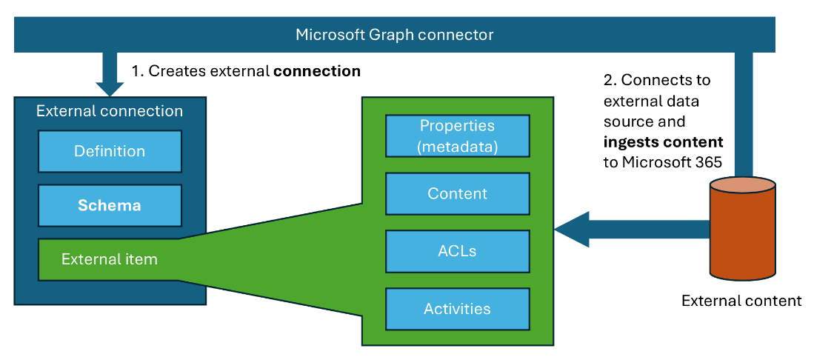
Graph Connector. Building blocks
Notes:
An external connection defines the source of external content that you’ll ingest into Microsoft 365. It contains information such as:
Name and description
Schema, which is a list of properties that are indexed for the external content
External content (referred to as external items) that are imported into Microsoft 365
Each external item contains:
Content that’s indexed
Metadata that describes the content as defined by the external connection schema (e.g., author of an item; when and by who it was last modified; where the content is located, etc.)
Access control list (ACL) that describes who is allowed to see the content
Optionally, activities on the content that support its discovery in the different Microsoft 365 experiences

Slide 10
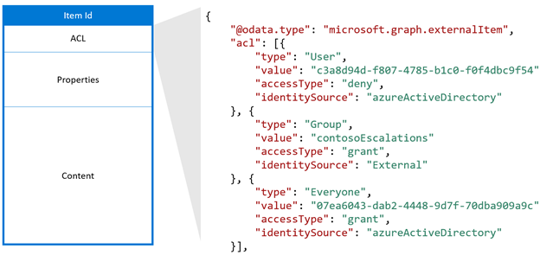
Access Control List – Breaking it down
Notes:
Using external groups in your connection
To use external groups in your connection, follow these steps:
For each non-Azure AD group, use the groups API to create an external group in Microsoft Graph.
Use the external group when defining the ACL for your external items as necessary.
Keep the membership of the external groups up to date and in sync.

Slide 11
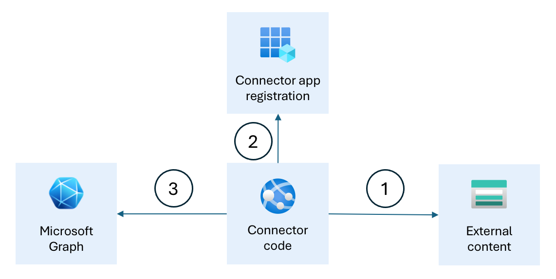
How they function together
Notes:
The Microsoft Entra app registration allows the Graph connector to authenticate with Microsoft 365 and call Microsoft Graph APIs. The Graph connector code creates the external connection and configures the schema. Then, regularly it connects to the external data source (1), authenticates with Microsoft Entra ID (2) and uses Microsoft Graph APIs to import the external content to Microsoft 365 (3).

Slide 12
Licensing and things to watch out for
Index Quotas
Each user license is entitled for 500 items of index quota.
IF a tenant has 50 licensed users, tenant is entitled for 25000 items
An item refers to a record which will be added to Microsoft Graph
Exceeding the quota could be achieved by further license purchases
Connection Limit : Total of 30 connections limit per tenant
Notes:
What is an item of index quota?
An item is 1 unit of index quota. Each entity (or record) from the source system that you add to Microsoft Graph can be considered an item. Each item added to Microsoft Graph shows up as a unique citation in a Copilot response and as a unique search result in Microsoft Search. Depending on the type of data source, 1 item is –
1 document (word, excel, ppt, pdf, etc.) in file share
1 wiki page in Confluence
1 webpage in a website
1 ticket/issue in Jira
Total quota utilized is calculated in terms of total items stored in the index. The number of updates/changes to an item are not counted in any manner.

Slide 13
Let us see it in action!!!
Ingesting Local Markdown Files
Full Blown API Integration Graph Connector

Slide 14


Demo Artefacts
Connect Me

Slide 15

Next Session
SPEAKERS PANEL
Creating Interactive Components in Power Pages
11.45 AM – 12.30 PM
Bhargav Reddy
Solution Architect

Slide 16
Thank You

Slide 17
Appendix

Slide 18
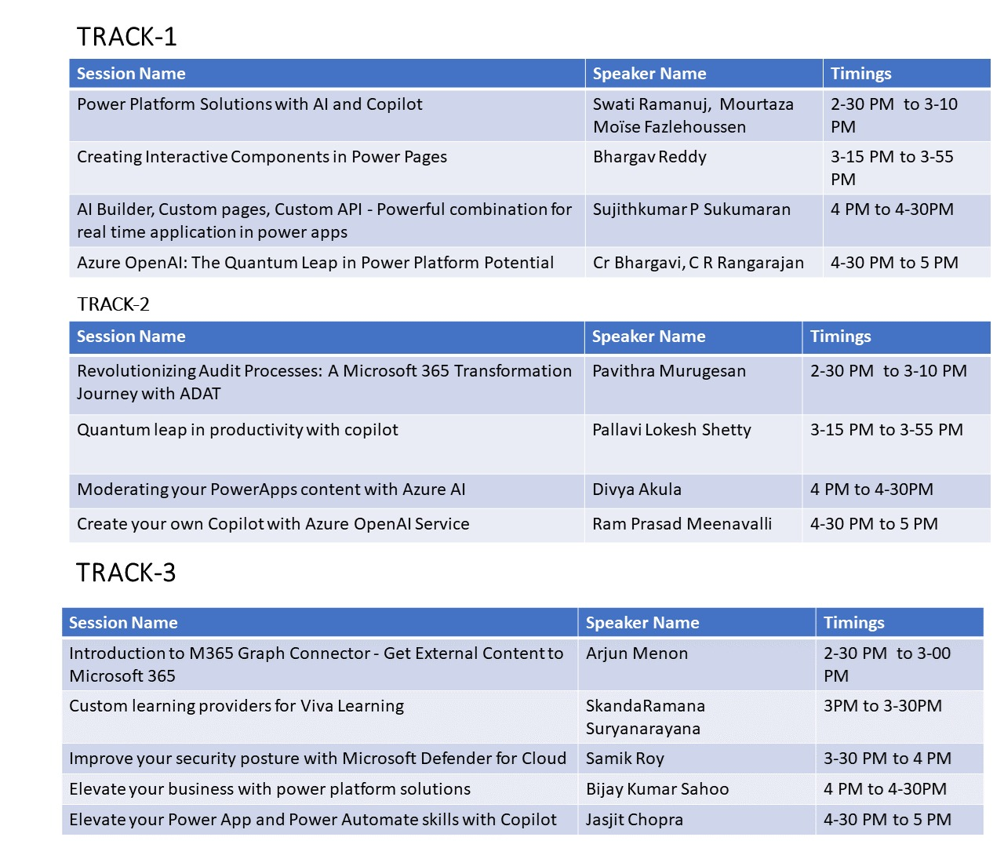

Slide 19
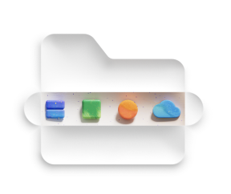
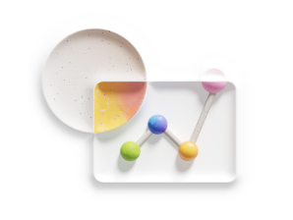

Why Graph Connectors are relevant
Grounding the data for Copilot
Unifying the Search Experience
Data in single canvas without context switching

